Slide 1
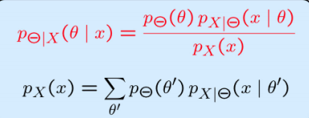
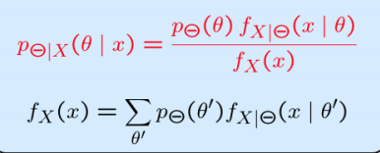
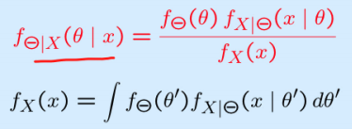
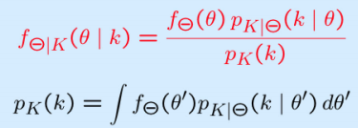
Bayesian Inference
Discrete with Discrete
Discrete Parameter with continuous observation
continuous with continuous
Continuous Parameter with Discrete observation

